Slide 1
Data Mining
Ensemble Techniques
Introduction to Data Mining, 2nd Edition
by
Tan, Steinbach, Karpatne, Kumar

Slide 2
Ensemble Methods
Construct a set of base classifiers learned from the training data
Predict class label of test records by combining the predictions made by multiple classifiers (e.g., by taking majority vote)

Slide 3
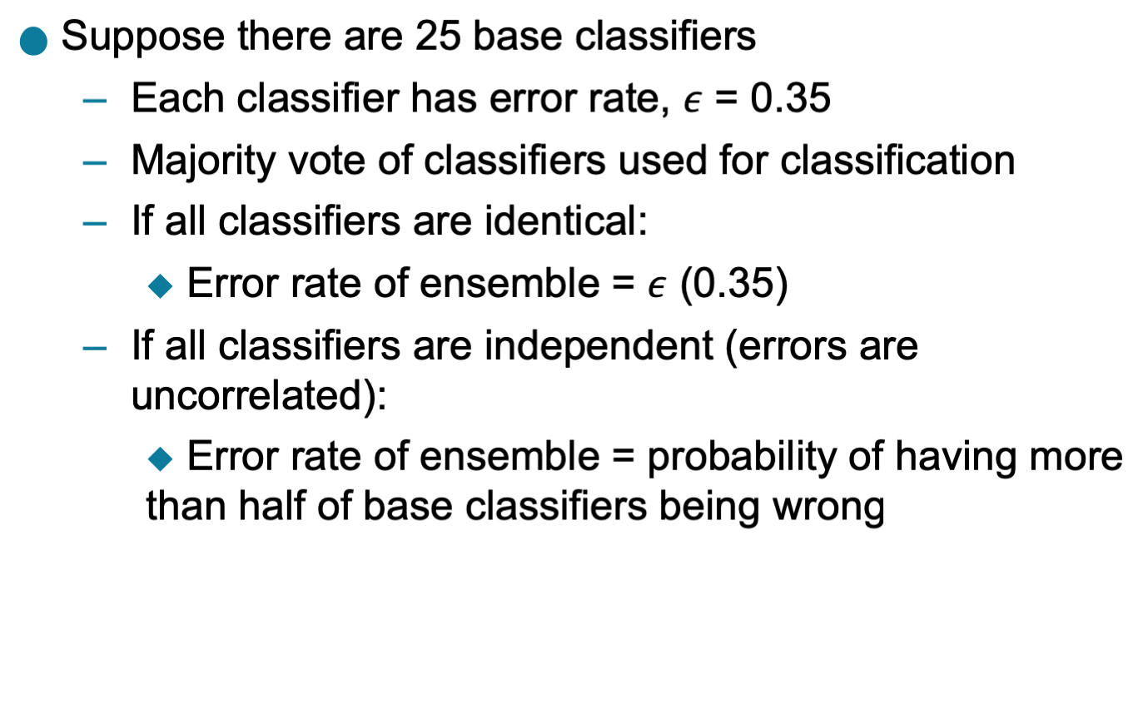
Example: Why Do Ensemble Methods Work?

Slide 4
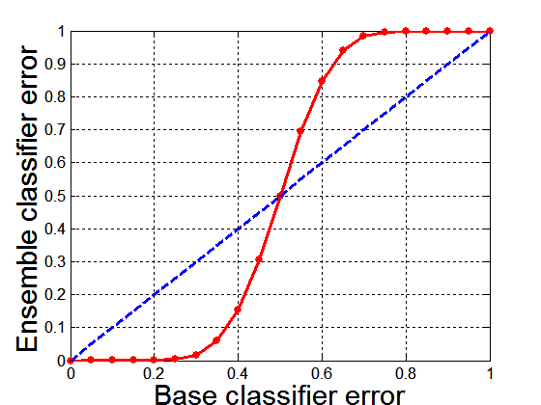
Necessary Conditions for Ensemble Methods
Ensemble Methods work better than a single base classifier if:
  All base classifiers are independent of each other
  All base classifiers perform better than random guessing (error rate < 0.5 for binary classification)
Classification error for an ensemble of 25 base classifiers, assuming their errors are uncorrelated.

Slide 5
Rationale for Ensemble Learning
Ensemble Methods work best with unstable base classifiers
  Classifiers that are sensitive to minor perturbations in training set, due to high model complexity
  Examples: Unpruned decision trees, ANNs, …

Slide 6

Bias-Variance Decomposition
Analogous problem of reaching a target y by firing projectiles from x (regression problem)
For classification, the generalization error of model $m$ can be given by:
$gen.error\left(m\right)=bias\left(m\right)+variance(m)$ + noise ($m$)

Slide 7
Bias-Variance Trade-off and Overfitting
Overfitting
Underfitting
Ensemble methods try to reduce the variance of complex models (with low bias) by aggregating responses of multiple base classifiers

Slide 8
General Approach of Ensemble Learning
Using majority vote or weighted majority vote
(weighted according to their accuracy or relevance)

Slide 9
Constructing Ensemble Classifiers
By manipulating training set
  Example: bagging, boosting, random forests
By manipulating input features
  Example: random forests
By manipulating class labels
  Example: error-correcting output coding
By manipulating learning algorithm
  Example: injecting randomness in the initial weights of ANN

Slide 10
Bagging (Bootstrap AGGregatING)
Bootstrap sampling: sampling with replacement
Build classifier on each bootstrap sample
Probability of a training instance being selected in a bootstrap sample is:
  1 – (1 - 1/n)^{n} (n: number of training instances)
  ~0.632 when n is large

Slide 11
Bagging Algorithm

Slide 12
Bagging Example
Consider 1-dimensional data set:
Classifier is a decision stump (decision tree of size 1)
  Decision rule: x ≤ k versus x > k
  Split point k is chosen based on entropy
x ≤ k
True
False
y_{left}
y_{right}

Slide 13
Bagging Example

Slide 14
Bagging Example

Slide 15
Bagging Example

Slide 16
Bagging Example
Summary of Trained Decision Stumps:

Slide 17
Bagging Example
Use majority vote (sign of sum of predictions) to determine class of ensemble classifier
Bagging can also increase the complexity (representation capacity) of simple classifiers such as decision stumps
Predicted Class

Slide 18
Boosting
An iterative procedure to adaptively change distribution of training data by focusing more on previously misclassified records
  Initially, all N records are assigned equal weights (for being selected for training)
  Unlike bagging, weights may change at the end of each boosting round

Slide 19
Boosting
Records that are wrongly classified will have their weights increased in the next round
Records that are classified correctly will have their weights decreased in the next round
Example 4 is hard to classify
Its weight is increased, therefore it is more likely to be chosen again in subsequent rounds

Slide 20
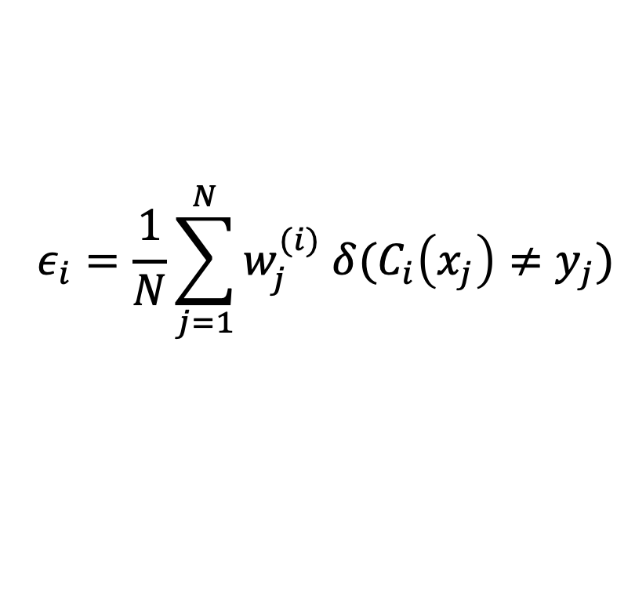
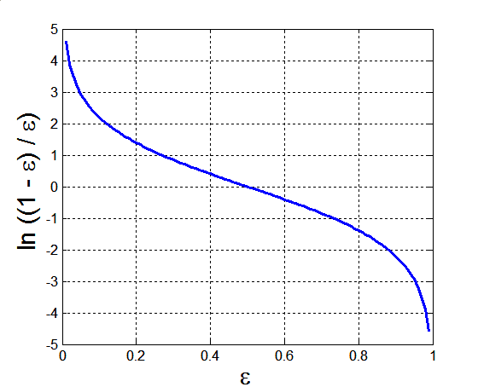
AdaBoost
Base classifiers: C₁, C₂, …, C_{T}
Error rate of a base classifier:
Importance of a classifier:

Slide 21
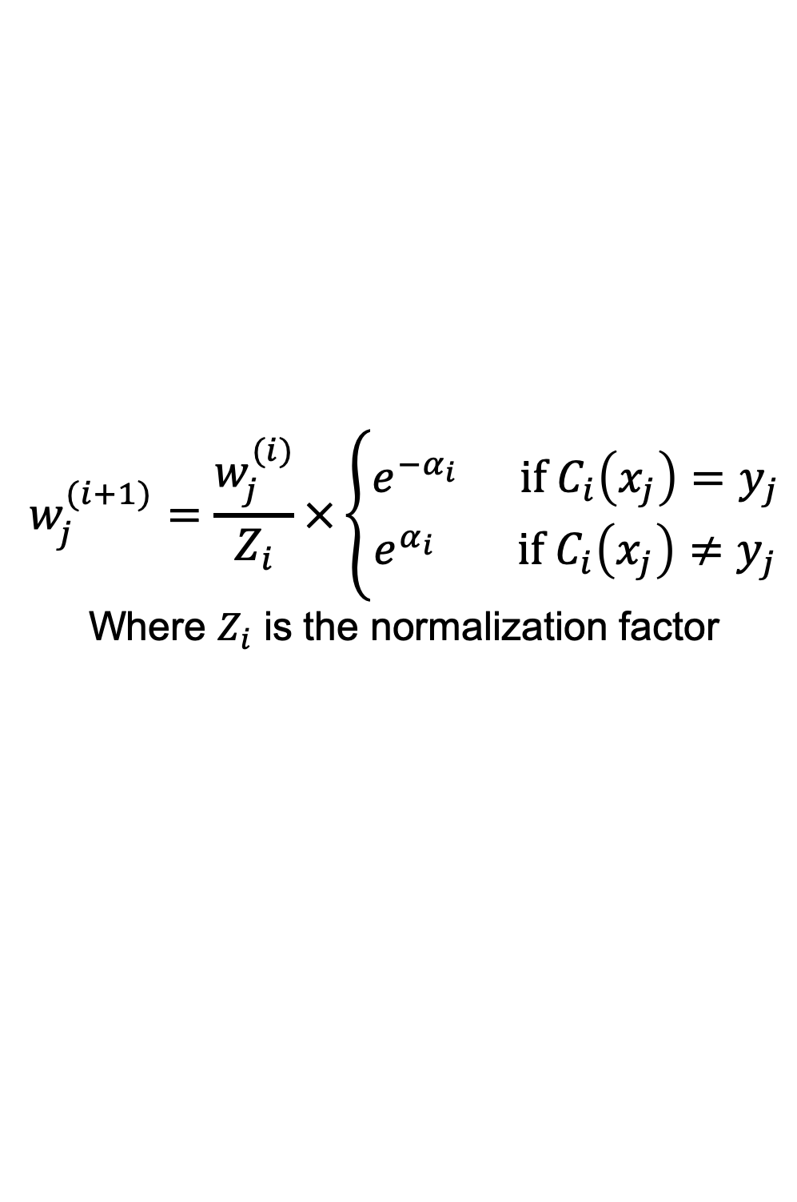
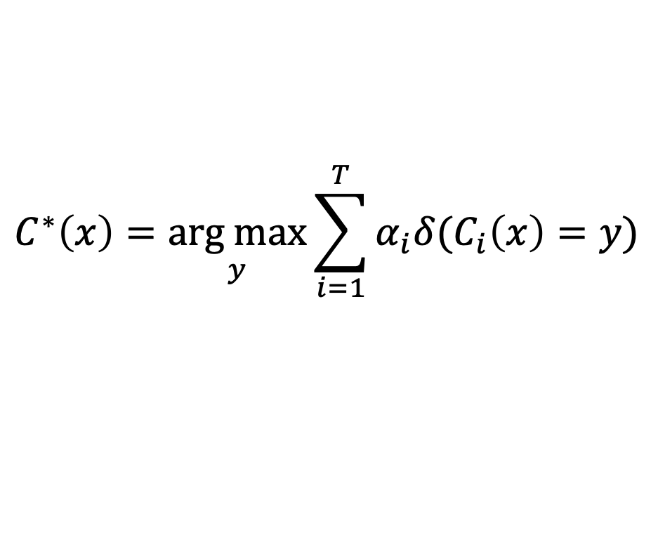
AdaBoost Algorithm
Weight update: (eq. 1)
If any intermediate rounds produce error rate higher than 50%, the weights are reverted back to 1/n and the resampling procedure is repeated
Classification:

Slide 22
AdaBoost Algorithm
1, slide 21

Slide 23
AdaBoost Example
Consider 1-dimensional data set:
Classifier is a decision stump
  Decision rule: x ≤ k versus x > k
  Split point k is chosen based on entropy
x ≤ k
True
False
y_{left}
y_{right}

Slide 24
AdaBoost Example
Training sets for the first 3 boosting rounds:
Summary:

Slide 25
AdaBoost Example
Weights
Classification
Predicted Class

Slide 26
Random Forest Algorithm
Construct an ensemble of decision trees by manipulating training set as well as features
  Use bootstrap sample to train every decision tree (similar to Bagging)
  Use the following tree induction algorithm:
    At every internal node of decision tree, randomly sample p attributes for selecting split criterion
    Repeat this procedure until all leaves are pure (unpruned tree)

Slide 27
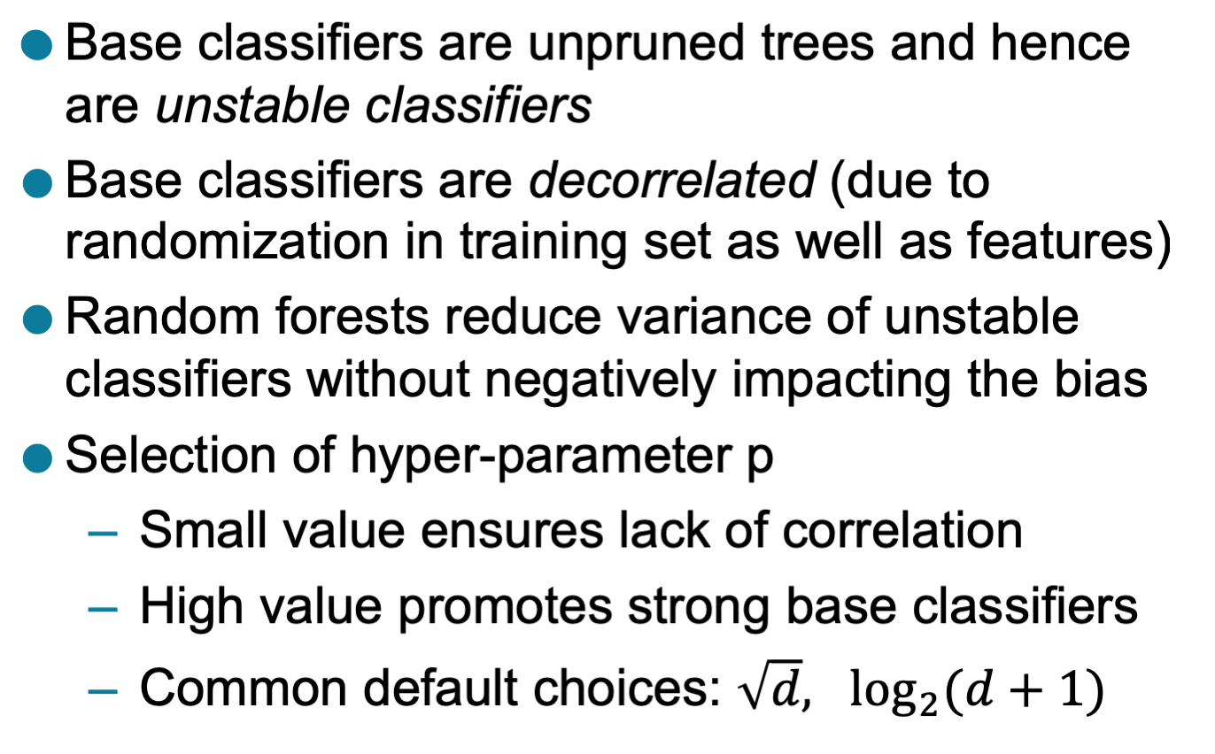
Characteristics of Random Forest

Slide 28
Gradient Boosting
Constructs a series of models
  Models can be any predictive model that has a differentiable loss function
  Commonly, trees are the chosen model
    XGboost (extreme gradient boosting) is a popular package because of its impressive performance
Boosting can be viewed as optimizing the loss function by iterative functional gradient descent.
Implementations of various boosted algorithms are available in Python, R, Matlab, and more.

